Slide 1
Intelligent Classification of Rural Infrastructure Projects using machine learning
CAPSTONE PROJECT
Presented By:
VISHESHA NERALI - S.G BALEKUNDRI INSTITUTE OF TECHNOLOGY- CE

Slide 2
OUTLINE
Problem Statement (Should not include solution)
Proposed System/Solution
System Development Approach (Technology Used)
Algorithm & Deployment
Result (Output Image)
Conclusion
Future Scope
References

Slide 3
Problem Statement
The Pradhan Mantri Gram Sadak Yojana (PMGSY) is a flagship rural development program in India, initiated to provide all-weather road connectivity to eligible unconnected habitations. Over the years, the program has evolved through different phases or schemes (PMGSY-I, PMGSY-II, RCPLWEA, etc.), each with potentially distinct objectives, funding mechanisms, and project specifications. For government bodies, infrastructure planners, and policy analysts, efficiently categorizing thousands of ongoing and completed projects is crucial for effective monitoring, transparent budget allocation, and assessing the long-term impact of these schemes. Manual classification is time-consuming, prone to errors, and scales poorly. Your specific task is to design, build, and evaluate a machine learning model that can automatically classify a road or bridge construction project into its correct PMGSY_SCHEME based on its physical and financial characteristics.

Slide 4
Proposed Solution
Develop a machine learning model that classifies The Pradhan Mantri Gram Sadak Yojana (PMGSY) through different phases or schemes (PMGSY-I, PMGSY-II, RCPLWEA, etc.)using data set provided, the model will process infrastructure planners, and policy analysts, efficiently categorizing thousands of ongoing and completed projects it will classify road or bridge construction project in less time and less error.
Key components
Data Collection: AI Kosh dataset .
Pre-processing: Clean and normalize the data set.
Machine learning algorithm: Train a classification model using P8-XGB Classifier.
Deployment: Deploy the solution on a scalable and reliable platform IBM Cloud.
Evaluation: Validate the model using accuracy and precision.
Result: Assist government agencies to categorize PMGSY quickly and accurately.

Slide 5
System Approach
The "System Approach" section outlines the overall strategy and methodology for developing and implementing Intelligent Classification of Rural Infrastructure Projects (PMGSY) .Here's a suggested structure for this section:
System requirements
IBM Cloud
watsonx.ai studio for model development and deployment.
watsonx.ai Runtime
Cloud storage object for dataset handling.

Slide 6
Algorithm & Deployment
In the Algorithm section, describes the machine learning algorithm chosen for predicting PMGSY. Here's an example structure for this section:
Algorithm Selection:
P8-XGB Classifier
Data Input:
State Name, District Name,PMGSY Scheme, No of road worked sanctioned, Length of road worked sanctioned, No of bridges sanctioned, Cost of work sanctioned, No Of road works completed, Length of road work completed, No of bridges completed, Expenditure occurred, No of road works balance, Length of road work balance, No of bridge balance.
Training Process:
Supervised learning using labelled PMGSY types.
Prediction Process:
Model deployed on IBM watsonax.ai Studio with API endpoint real-time predictions.

Slide 7
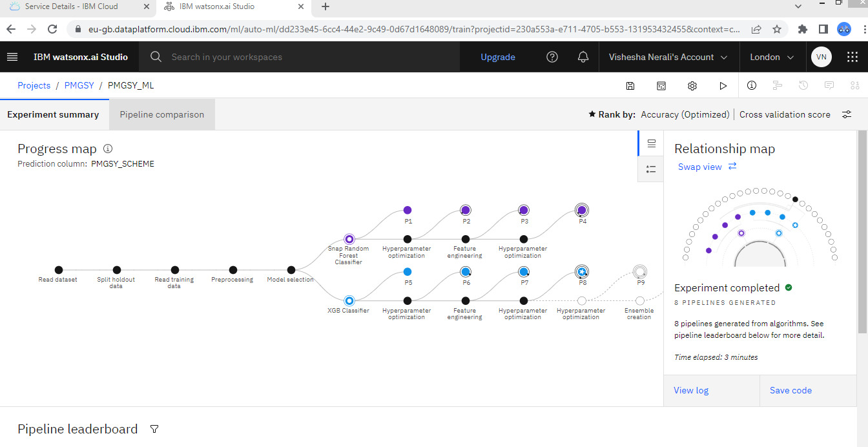
progress map

Slide 8
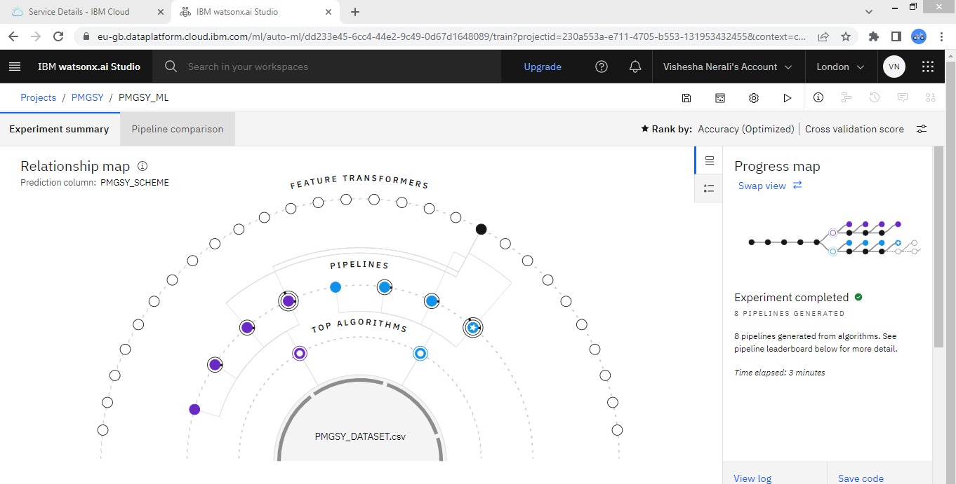
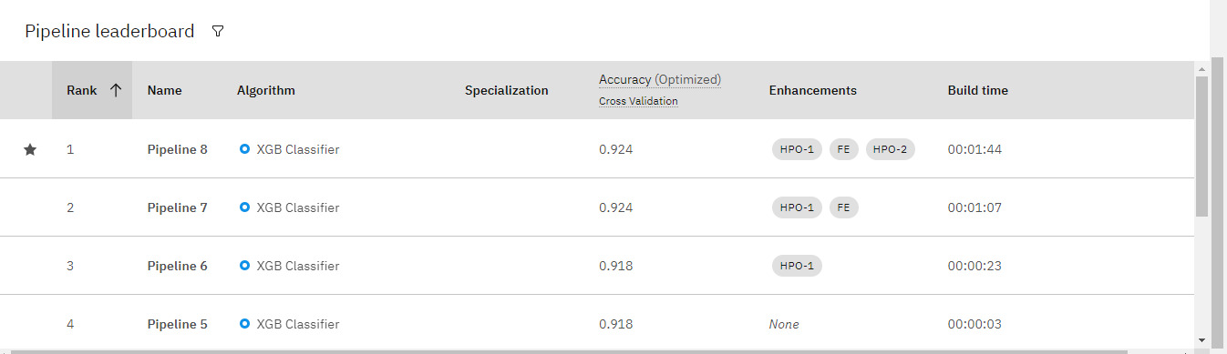
relationship map

Slide 9
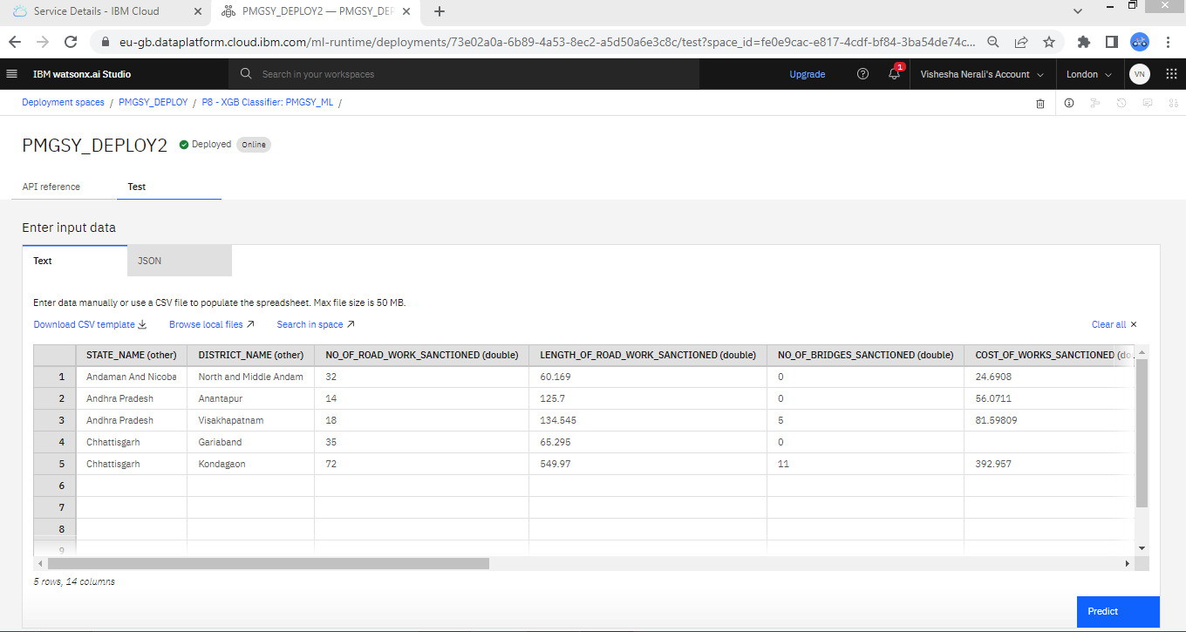
Input data

Slide 10
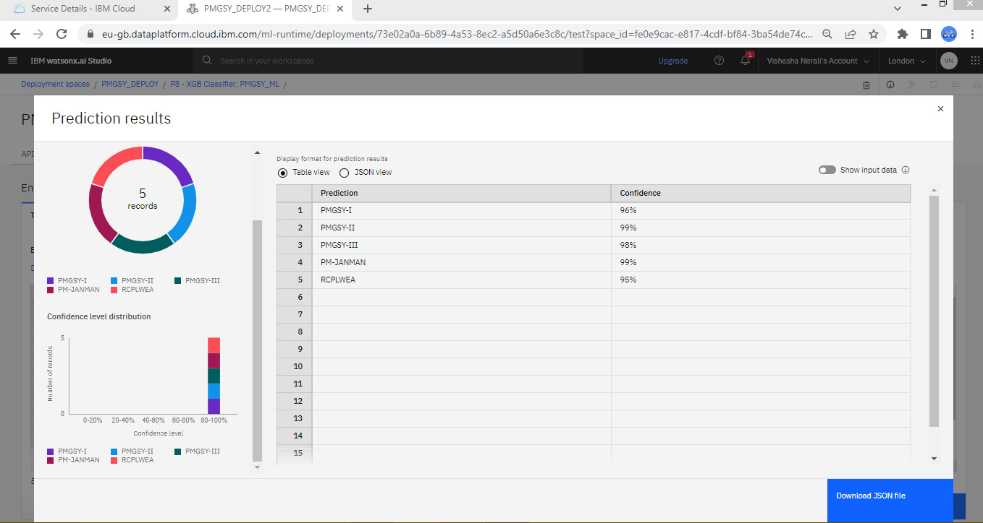
Result

Slide 11
Conclusion
Summarize the findings and discuss the effectiveness of the proposed solution. Highlight any challenges encountered during the implementation and potential improvements. Emphasize the importance of Use of Machine Learning in the project minimizes errors and saves time and gives clear idea of project.

Slide 12
Future scope
Discuss potential enhancements and expansions for the system. This could include incorporating additional data sources, optimizing the algorithm for better performance, and expanding the system to cover multiple cities or regions. Consider the integration of emerging technologies such as edge computing or advanced machine learning techniques.

Slide 13
References
Intelligent Classification of Rural Infrastructure Projects PMGSY dataset was collected from aikosh: https://aikosh.indiaai.gov.in/web/datasets/details/pradhan_mantri_gram_sadak_yojna_pmgsy.html
IBM cloud, watxonx.ai Studio, machine learning algorithms, best practices in data pre-processing, model evaluation, and articles were instrumental in developing the proposed solution. This could include academic papers on PMGSY prediction,

Slide 14
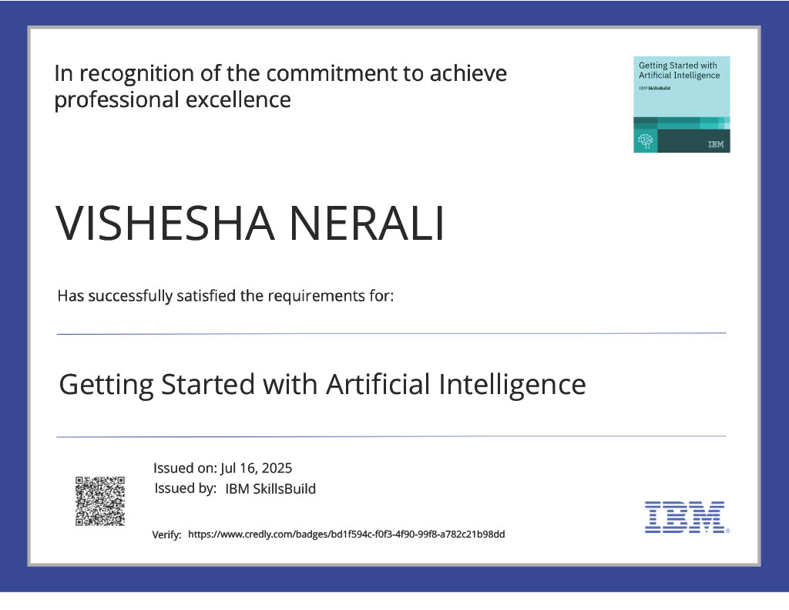
IBM Certifications

Slide 15

IBM Certifications

Slide 16
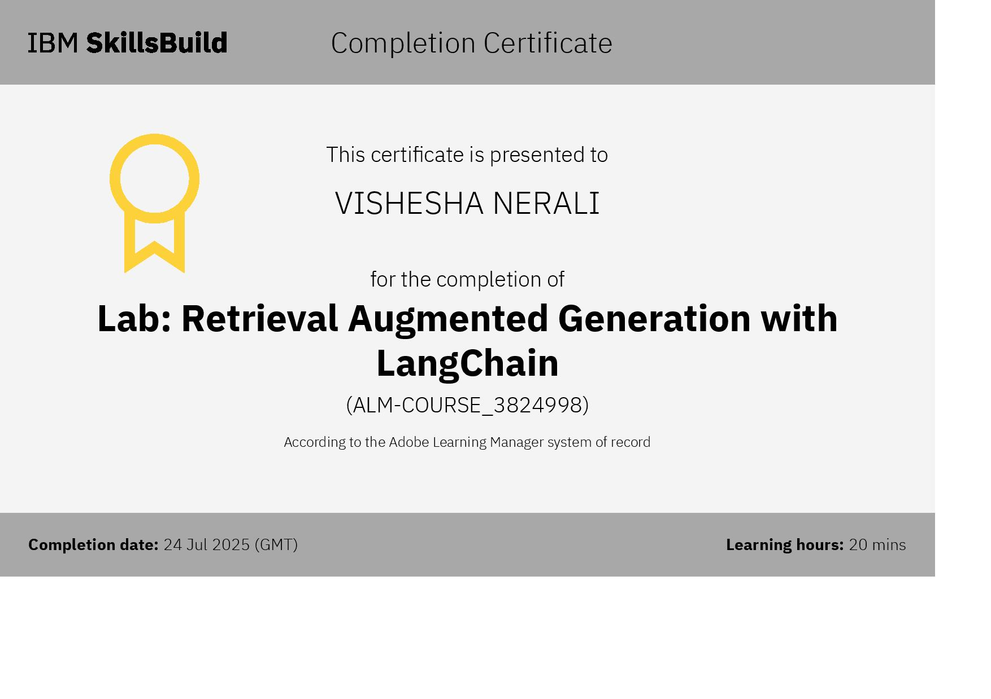
IBM Certifications

Slide 17
THANK YOU

